Slide 1

Appendix A:
Slide Sets 1.1

Slide 2
Early Goal Directed Therapy
Begin within 6 hours for sepsis
Begin immediately for hypotension or lactate > 4
  Do NOT delay for ICU admission!
Goals:
    Central Venous Pressure 8-12
    Mean Arterial Pressure >65
    Urine Output>0.5mL/kg/hr
    Central Venous (SVC) oxygen Saturation >70% or Mixed Venous oxygen Saturation >65%
Slide Set 1.1

Slide 3
Early Goal Directed Therapy
Crystalloids or Colloids
  Crystalloid start @ 1000ml/30min
  Colloid start @ 300-500ml/30min
  Crystalloids no worse than colloids and less expensive
Increase rate for tissue hypoperfusion
Decrease rate for increased cardiac filling pressures without hemodynamic improvement
Slide Set 1.1

Slide 4
Appendix A:
Slide Sets 1.2

Slide 5
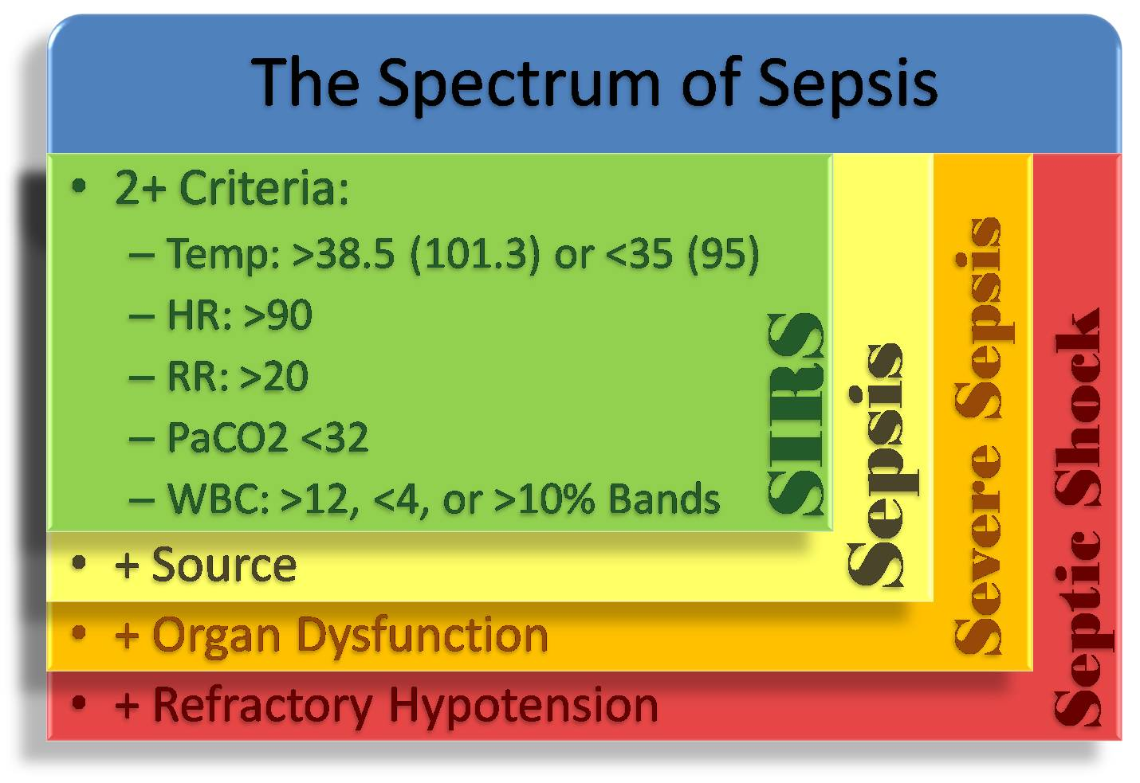
“Organ Dysfunction”
“Multiple Organ Dysfunction Syndrome”
Increasing number of impaired systems correlates w/ higher mortality
Parameters to Monitor:
Pulmonary - PO2/FiO2 ratio
Renal – Serum Creatinine
Hematologic – Platelet count
Neurologic – Glasgow Coma Scale
Hepatic - Serum Bilirubin
Cardiac - Pressure Adjusted HR
“Refractory Hypotension”
Mean Arterial Pressure <60 after adequate IV fluid resuscitation
“Adequate IV fluid resuscitation”
20-30 ml/kg Starch
or
40-60 ml/kg NS
Neuro:
Altered
SIRS
Severe Sepsis
Sepsis
Septic Shock
• + Source
MODS
• + Organ Dysfunction
• + Refractory Hypotension
• + High Mortality Rate
Slide Set 1.2

Slide 6
2+ Criteria:
-Temp >38.5C (101.3 ) or < 35 C (95)
-HR > 90 beats per minute
-Respiratory Rate > 20 breaths per minute
-PaCo2 < 32
- White Blood Cell Count > 12k, <4k or
>10% bands
SIRS
Slide Set 1.2

Slide 7
“Source”
A positive culture or Gram stain (blood, urine or sputum)
or
Visual evidence of infection (i.e. purulent wound)
SIRS
Sepsis
Slide Set 1.2

Slide 8
Neuro:
Altered Mental Status
Abnormal EEG
CVS:
Cardiac dysfunction on echocardiogram
Lactate >2
Pulm:
Acute Lung Injury
ARDS
Renal:
Urine Output <0.5mL/kg
for 1hour
Heme:
Platelet <100k
Disseminated Intravascular Coagulation
Derm:
Capillary refill > 3 sec
Mottled skin
“Organ Dysfunction”
SevereSepsis
SIRS
Sepsis
Slide Set 1.2

Slide 9
“Refractory Hypotension”
Mean Arterial Pressure <60 after adequate IV fluid resuscitation
(MAP < 80 in a patient with history of hypertension!)
“Adequate IV fluid resuscitation”
20-30 ml/kg Starch
or
40-60 ml/kg NS
Septic Shock
Slide Set 1.2

Slide 10
“Multiple Organ Dysfunction Syndrome”
Increasing number of impaired systems correlates w/ higher mortality
Parameters to Monitor:
Pulmonary - PO2/FiO2 ratio
Renal – Serum Creatinine
Hematologic – Platelet count
Neurologic – Glasgow Coma Scale
Hepatic - Serum Bilirubin
Cardiac - Pressure Adjusted HR
MODS
Slide Set 1.2

Slide 11
Appendix A:
Slide Sets 2.1

Slide 12
Physiology
Note: These physiologic response mechanisms are the host’s response to an infection, not the actions of the infection itself!
Cardiovascular:
  Vasodilation
  Increased microvascular permeability
Pulmonary:
  Interstitial/alveolar edema
  V/Q mismatch
GI:
  Fasting, bacterial overgrowth, aspiration/translocation
  Liver dysfunction impairs clearance of toxins
Renal:
  Acute kidney injury
  Depressed ADH
Neuro:
  “Critical illness polyneuropathy”
Slide Set 2.1

Slide 13
Hemodynamics
Vasopressors
  Goal: MAP >65
  Guidelines recognize 2 equal options:
    Levophed (NE): 0.5-1mcg/min, max 30mcg/min
      Agonist: α₁, α₂, β₁
      Vasoconstriction, ↑CO
    Dopamine (DA): 1-50mcg/kg/min
      Increased incidence of arrhythmic events with dopamine
      Dosing/ effect:
        Start at 2-4mcg/kg/min
        Increased HR/contractility, ↑CO
        Potent vasoconstriction at higher doses
  For persistent hypotension WITH low CO add:
    Dobutamine: 0.5-1mcg/kg/min, max 40mcg/kg/min
      Selective β₁ agonist
      Increased HR/contractility, ↑CO
Slide Set 2.1

Slide 14
Hemodynamics
Stress-Dose Steroids
  Controversial!
  Only after IVFR and pressors
  Hydrocortisone IV: Start at 50mg Q6H, taper over 1-2wks
Recombinant Activated Protein C (Xigris)
  “Clinical assessment of high risk of death.”
Transfusion
  Target Hgb 7-9 unless known CAD or hemorrhage
Slide Set 2.1

Slide 15
Appendix A:
Slide Sets 2.2

Slide 16
Microbiology
Line infection
  Staph (MSSA/MRSA)
Biliary tract
  E. coli, Klebsiella, Enterococcus
Intraabdominal/Pelvic
  B. fragilis
Urosepsis
  Aerobic GNR
Slide Set 2.2

Slide 17
Antibiotics
Blood Cultures PRIOR to Antibiotics
Begin as soon as possible when infection is suspected
Broad Spectrum: example regimen
    Vancomycin: Gram positive coverage
    Meropenem, Levofloxacin: Double pseudomonal coverage when it is suspected as a pathogen
    7-10 Day Course
Other considerations:
    Antifungals/antivirals
    Acinetobacter
    Penicillin allergy
    Local antibiogram
    Narrow coverage when speciation/susceptability become available
Slide Set 2.2

Slide 18
Targeting the Infection
Persistent fever and elevated WBC despite adequate antibiotic coverage may indicate need for source control
Imaging studies
  CXR
  CT Abdomen/Pelvis
  CT Head/Neck
Source Control
  Abscess drainage
  Wound debridement
Slide Set 2.2

Slide 19
Appendix A:
Slide Sets 2.3

Slide 20
GRADE System
Quality of Evidence:
  A-High
  B-Moderate
  C-Low
  D-Very Low
Strength of Recommendation:
  1 - Strong
  2 - Weak
Slide Set 2.3

Slide 21
Surviving Sepsis Campaign:
2008 Updated Guidelines
Early Goal Directed Resuscitation (1B)
  Fluid Challenge (1C)
  Rate Reduction (1D)
Vasopressors (1C)
Dobutamine for low CO (1C)
Stress-Dose Steroids (2C)
Recombinant Activated Protein C (2B)
Transfusion - Goal Hgb 7-9 (1B)
Broad Spectrum Antibiotics
  Within one hour (1B)
  Blood Cx prior to Abx (1C)
  Reassess and Narrow Coverage (1C)
  7-10 Day Course (1D)
Imaging studies (1C)
Source Control (1C)
Glycemic Control: FSG <150 (2C)
Hemodialysis (2B)
Slide Set 2.3

Slide 22
Surviving Sepsis Campaign:
2008 Updated Guidelines
ALI/ARDS:
  Low Tidal Volume (1B)
  Limit Plateau Pressure (1C)
  Apply PEEP (1C)
  Elevate HOB (1B)
  Avoid PAC (1A)
  Conservative fluid if not in shock (1C)
Protocols for weaning/sedation/analgesia (1B)
Intermittent bolus or daily lightening of sedation (1B)
Avoid Neuromuscular Blockade (1B)
DVT prophylaxis (1A)
Stress Ulcer Prophylaxis:
  H2 Blocker (1A)
  PPI (1B
Slide Set 2.3

Slide 23
Appendix B:
Test Results: Parts I and II

Slide 24
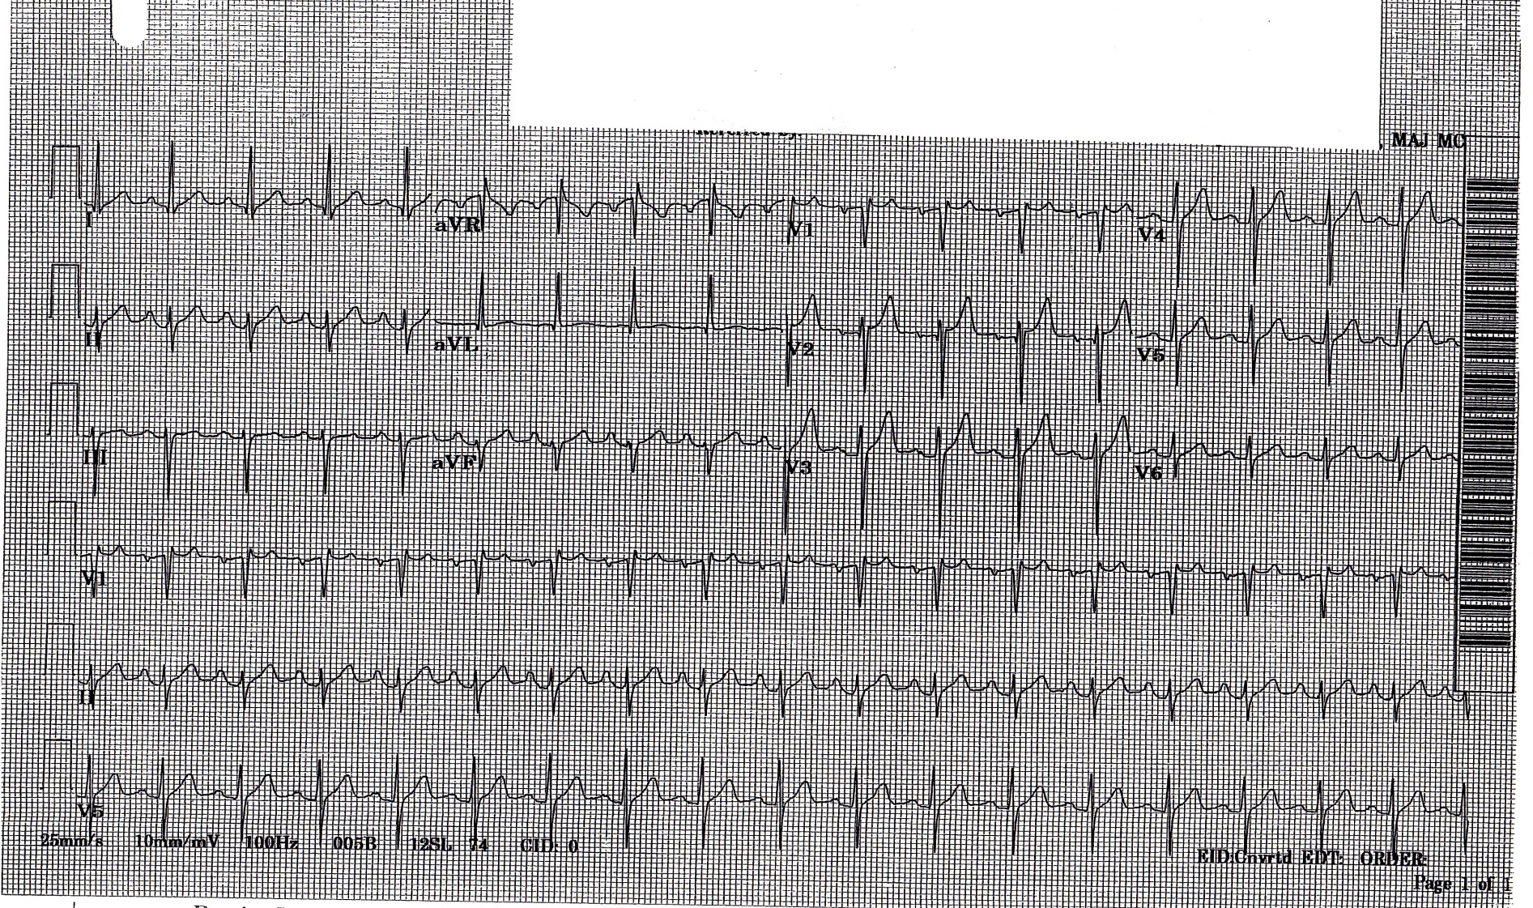
ECG
Test Results: Part I

Slide 25
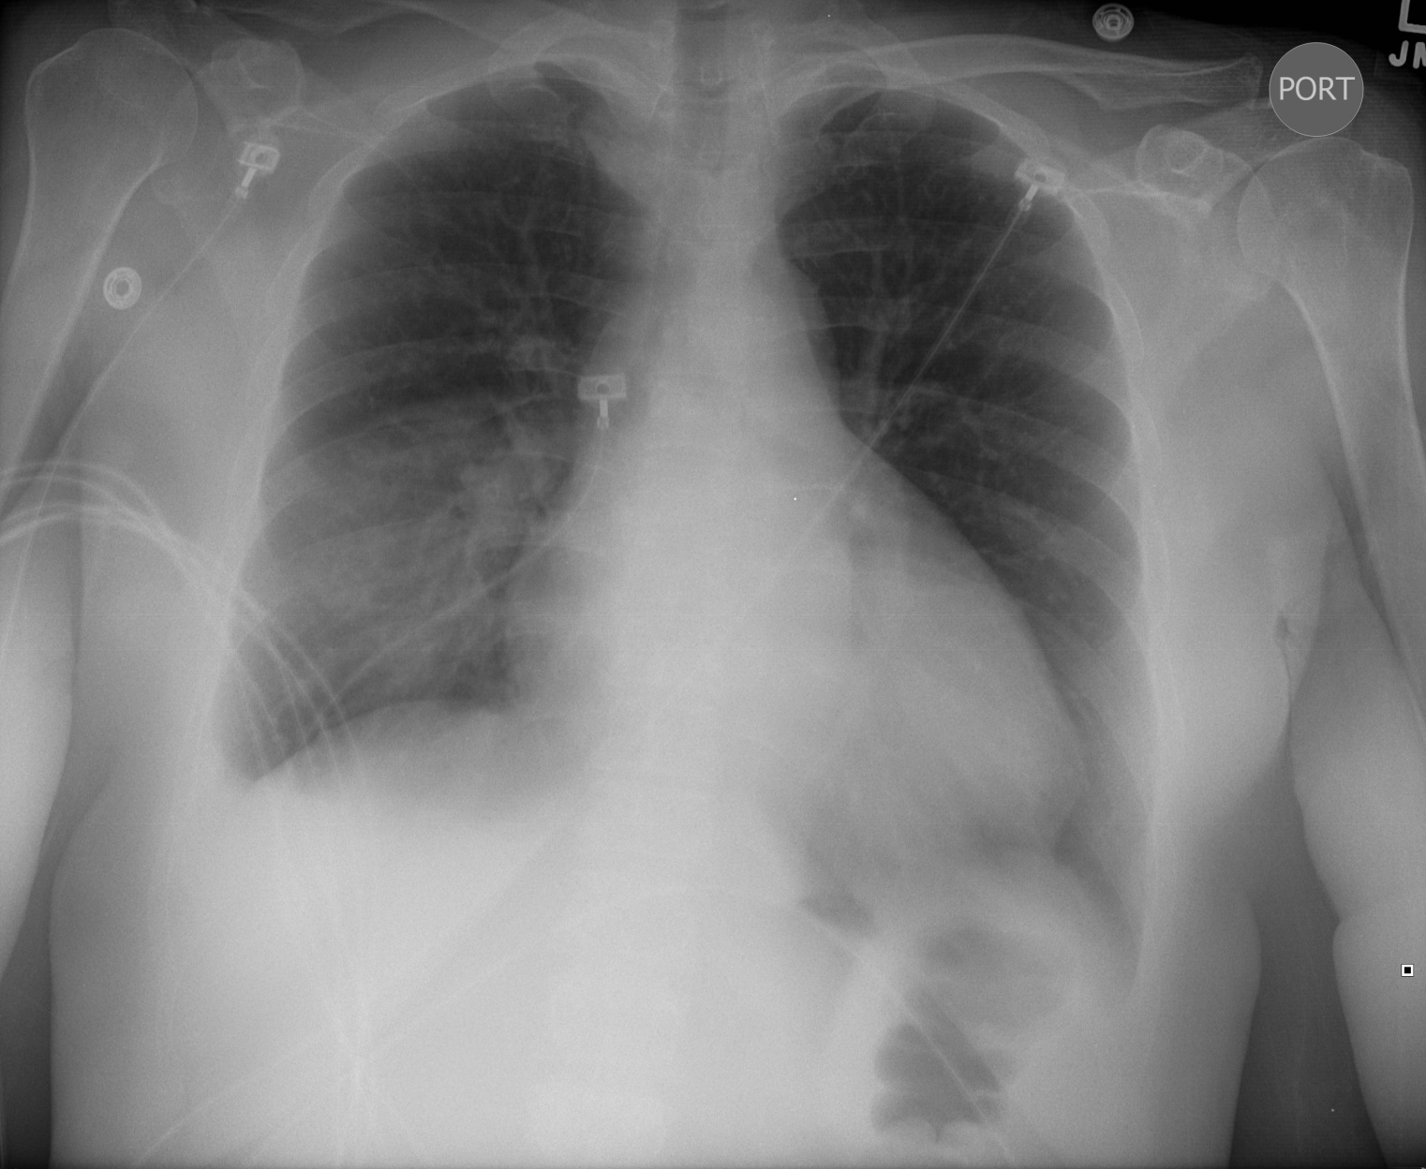
CXR
Test Results: Part I

Slide 26
Lab Studies
CBC:
Differential: 91% Neu, 6% Lym, 2% Mono, 8 Bands, 2 Segs
BMP:
Urinalysis:
  Appearance: Clear, straw colored
  Glucose/protein/ketones/nitrites/leukocyte esterase: Negative
  Bacteria/WBC: None
ABG: pH 7.30, PaCO2 31, PaO2 75, HCO3 14
Lactate: 4.7
13.0
19.1
214
38.2
140
110
29
214
4.5
12
1.4
Test Results: Part I

Slide 27
Lab Studies
Gram Stains:
  Blood: Gram negative rods and gram positive cocci in clusters
  Sputum: Gram negative rods and gram positive cocci in clusters
  Urine: No organisms
Cultures/Speciation/Sensitivities: Pending
Test Results: Part II

Slide 28
Appendix C:
Sepsis Bundle Example

Slide 29
Sepsis Bundle example
SIRS Criteria
-Temp >38.5C (101.3 ) or < 35 C (95)
-HR > 90 beats per minute
-Respiratory Rate > 20 breaths per minute
-PaCo2 < 32
- White Blood Cell Count > 12k, <4k or >10% bands
Suspected Sepsis
YES
NO
Clinically re-assess q-shift
+ Infectious source
=Sepsis
Initiate Early Goal Directed Therapy
Check Indicators/ Screening Tools:
Sepsis score, Lactate, BP
Lactate < 2, normotensive, no end organ dysfunction
Lactate >4, SBP < 90 , or SBP drop > 30mmHg
=Severe Sepsis
Normotensive, Lactate 2-4, or organ dysfunction
Confirm cultures drawn
Give appropriate antibiotics
Reassess lactate in 8 hours x 1, repeat as needed
Check for end organ dysfunction daily
Confirm cultures drawn and antibiotics given
Aggressive IV fluids
Re-check lactate every 4 hours x 3
Re assess for end organ dysfunction daily
Fluid Bolus (ex. 20ml/ kg)
Monitor CVP
responsive
No
response
Parameter
Goal
If
Then
Step 1
CVP 8-12mmHg <8 Give NS/ LR bolus until CVP 8-12, continue to monitor
>12 No action, go to step 2
Step 2
MAP 60-90mmHg <60 Arterial line, give pressors, consider random cortisol, steroids
Goals Achieved yes Re check lactate q8 hours x 3
no Re-assess steps 1-2. Consider mechanical ventilation

