Slide 1
Understanding and Preventing Cognitive Errors in Healthcare
Marjorie Stiegler, M.D.
Department of Anesthesiology
University of North Carolina at Chapel Hill

Slide 2
Safety Experts Agree
Most errors are “thinking mistakes”
Decision-making is key in up to 80% of medical errors
Cognitive errors may be the #1 contributor to missed diagnoses and patient injury

Slide 3
“Cognitive Errors” are not:
Insufficient knowledge
Insufficient practice
Technical slips
Novel diagnoses

Slide 4
Cognitive Errors are:
Making mistakes even though you “know better”
Being influenced, often subconsciously, by non-rational or non-statistical decision factors

Slide 5
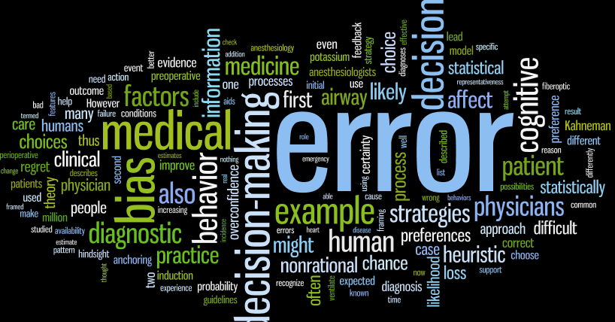
“Cognitive Errors” result from many processes:
Notes:
Nonrational preferences – not ridiculous or unreasonable. Not a lack of knowledge or skill
Discuss the cognitive infrastructure that fosters cognitive errors
Examples of cognitive errors
Counterbalancing strategies

Slide 6
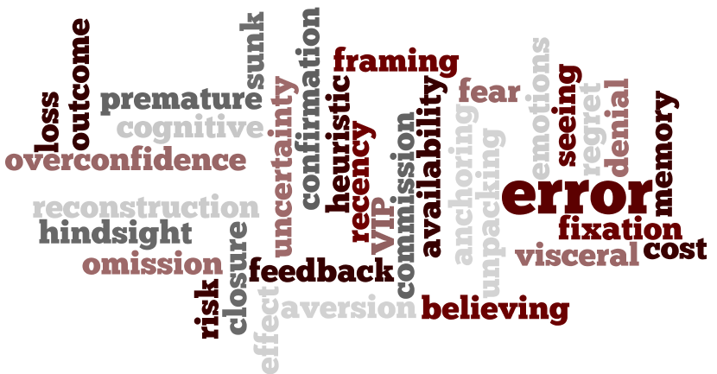
There are many biases and subconscious phenomena

Slide 7
Error Blindness
“Whatever falsehoods each of us believes are necessarily invisible to us. We can be wrong, or we can know it, but we can’t do both at the same time.”
- Kathryn Schulz

Slide 8
Counterbalancing Strategy:
“Rule of Three”
Diagnostic
  For any diagnosis, consider at least three plausible alternatives
Therapeutic
  Never repeat a maneuver for a third time without considering alternatives
Stiegler MP, Ruskin KJ. Curr Opin Anaesth. 2012

Slide 9
Counterbalancing Strategies
Universal antidote: “Could this be something else?”
Practice “worst case” medicine
Prospective hindsight
Test to exclude alternatives, not just confirm suspicions
Graber BMJ Qual Saf 2012

Slide 10
Overconfidence
Well known and ubiquitous human nature tendency
Might prevent clinicians from using counterbalancing strategies or cognitive aids for decision support
We recommend automatic use of decision support strategies, whether or not clinicians feel confident in their diagnoses and plans
Berner ES, Graber ML. Overconfidence as a cause of diagnostic error in medicine. Am J Med 2008;121:Suppl:S2-S23

Slide 11
Encourage Combined Reasoning
Trust experience and familiarity, but do not base diagnoses on these senses alone
Use decision support tools such as counterbalancing strategies, cognitive aids, and deliberate engagement with Type II analysis
Eva KW, et al. Teaching from the clinical reasoning literature: combined reasoning strategies help novice diagnosticians overcome misleading information. Med Educ 2007;41:1152–8.

Slide 12
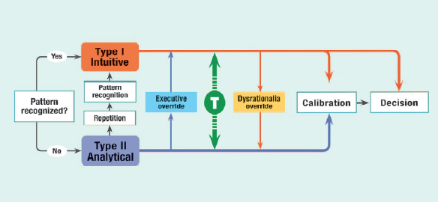
NOTE: Errors may be made at any point, including at the point of pattern recognition. This underscores the need to use decision support as an automatic matter of course, rather than only when unsure. Also, it emphasizes the need to engage in analytical thinking and calibration.
From: Stiegler MP, Tung A: Cognitive processes in anesthesiology decision making. Anesthesiology 2014; 120: 204-17

