Slide 2
COMFORT*
Communication (narrative)
Orientation and opportunity
Mindful presence
Family
Openings
Relating
Team
* Wittenberg-Lyles, E., Goldsmith, J., Ferrell, B., & Ragan, S. (2012). Communication and palliative nursing. New York: Oxford.
Notes:
Red indicates what this session will highlight as they are advanced level communication skills for hospice and palliative care

Slide 3
Objectives
Recognize the impact of clinician communication on patient/family care transitions
Understand communication privacy and self-disclosure
Learn how to engage in pivotal moments in illness

Slide 4
Junctures of Care
Initial diagnosis
Treatment decision-making
Recurrence/complication points
Coaching family/patient sharing

Slide 5
Pivotal Communication Points
  Spiritual needs
  Cultural needs
  End-of-life concerns
  Suffering
  Advanced care directives
  DNR orders
  Near Death:
  Departures
  Forgiveness
Notes:
The nurse is suited for these interactions because he/she has provided intimate physical care throughout disease process

Slide 6
Role of a Clinician: Openings
Attend to patient/family cues
Adaptive communication
  Based on patient/family acceptance
  Diffuse sensitive news
    recurrence, hospice, prognosis
Nuanced communication strategies
  Intimate conversations → facilitate openings
Notes:
Stewards of disease process
Pivotal points of communication mirror disease process
After receipt of bad news:
Challenges nurse communication

Slide 7
QOL Domains
(Ferrell & Coyle, 2008)
Clinician Communication: Beyond Bad News
Physical Well-Being
-Self-care
-Treatment
-Place of Care
Psychological Well-Being
-Distress
-Anxiety
-Fear
-Happiness
Social Well-Being
-Family Dynamics
-Caregiver Burden
-Relationships External to Family
-Identity
Spiritual Well-Being
-Connectedness
-Meaning of Illness
-Meaning of Suffering

Slide 8
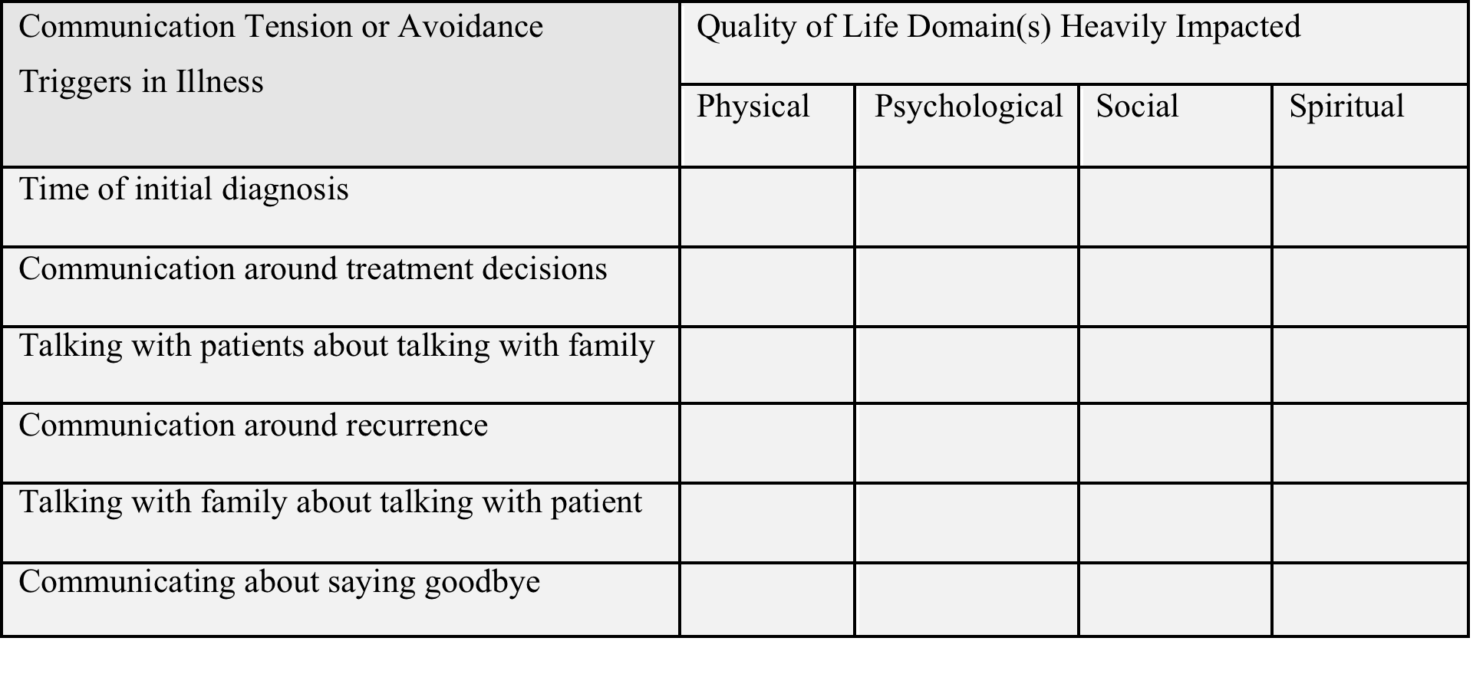
Quality of Life Domains and Openings

Slide 9
Communication Privacy Management*
Ownership of private information
In early palliative care:
  Prognosis
  Hospice/palliative care services
  Patient/caregiver burden
*Petronio, 2007

Slide 10
Communication Privacy Management
Control of private disclosures
Clinician:
  Intimate relationship → patient/family disclosure
  Receive/deliver private information
    Content/process (task communication)
    Facilitates impact on individual(s) receiving information (relational communication)

Slide 11
Aspects of Privacy Management*
Control of private information
Privacy dilemma
Boundary turbulence
Boundary coordination
*Petronio, 2007
Notes:
Next how applies to palliative care nursing

Slide 12
Self-Disclosure*
Self-disclosure:
  Process of bonding
  Superficial to intimate relationship
Penetration (2 properties)
  Breadth—number of topics
  Depth—level of intimacy guiding topic
Reciprocity
  Return of openness between people
  *Altman and Taylor, 1973

Slide 13
Tensions, Boundaries, Disclosures
Tension identified:
  What is being avoided between team and patient/family?
Boundary understanding:
  Describe boundary as either thick, thin, or permeable
Depth of Disclosure
  Recognize clinician self-disclosure is useful in reaching understanding
Notes:
Next how applies to palliative care nursing

Slide 14
Dispelling Myths
Common Myths: Communication with Patients and Families about Dying | Communication Realities
Avoid silence in difficult moments. Silence creates more awkwardness. | Silence allows for patient/family disclosure; communicates interest/presence.
Dying patients/families only want to talk about positive things. | Patients/family have existential concerns/fears to process.
Patients/families don’t want clinicians to ask questions about dying/loss. | Patients/families want to share a relationship with physicians and process questions about dying/loss.
When a patient is dying, health care professions have little to offer. | Health care professionals can provide comfort and assistance to family transitions in place/goals of care when a patient is dying.
Adaptations from Knauft, Nielson, Engelberg, Patrick, & Curtis, 2005; Kristjanson, 2001; Gauthier, 2008
Notes:
Inaccuracies and false assumptions remain regarding difficult

Slide 15
Clinician Relationship
Complementary behaviors:
  Show interest in patient/family as self-disclose
    Maintain focus on patient/family
  Most important to relational development
Reciprocal behaviors:
  Equals/surpasses patient/families conversational content (breadth, depth)
  Potential to dismiss or upstage patient/family experiences
Notes:
Complementary behaviors are more important/beneficial to patient-family-nurse intimacy than reciprocal behaviors
Intimacy in clinical setting positions clinicians in meaning-making process

Slide 16
Communication Tensions
Openings
Understanding / Disclosing
Place of Care: “I feel like I am losing everything.”
Recurrence: “Am I dying?”
If your family in open communication about your illness?
What have you relied on during other challenging times?
What do you see for the future?
What is most important right now?
Notes:
Complementary behaviors are more important/beneficial to patient-family-nurse intimacy than reciprocal behaviors
Intimacy in clinical setting positions clinicians in meaning-making process

Slide 17
Prompts for Engaging Family Learning
“You seem like you are feeling better about things today. I am interested to know what helped you?”
“Was my explanation unclear during our previous meeting?”
“What would have helped you in our discussion last week that you did not receive?”

Slide 18
Team-Based Openings
Provide a description of the challenging communication event to colleagues
Ask colleagues to share their views on how the event was approached and any suggestions about the communication that was exchanged
Identify point of tension within team meeting and plan team solutions

