Slide 2
COMFORT*
Communication (narrative)
Orientation and opportunity
Mindful presence
Family
Openings
Relating
Team
* Wittenberg-Lyles, E., Goldsmith, J., Ferrell, B., & Ragan, S. (2012). Communication and palliative nursing. New York: Oxford.
Notes:
Red indicates what this session will highlight as they are advanced level communication skills for hospice and palliative care

Slide 3
Objectives
Consider the impact of multiple communication goals
Adapt to patient and family perspectives
Engage critical turning points from a relational perspective

Slide 4
Adapting to Patient and Family
“Bad news” might not be so bad
Radically adaptive engagement
Diffusion of Topics
Acceptability

Slide 5
Understanding the Quest *
The discovery of something useful from the experience
Acknowledgement of significant changes
Rewriting a no-longer-useful story of cure
Acknowledgement signifies a move toward acceptability
*Frank, 1995

Slide 6
Engaging Uncertainty
Changing probabilities about the disease creates:
  Uncertainty for patient
  Uncertainty for family
  Changing values about what quality of life is acceptable

Slide 7
Problematic Integration*
Two concepts for dealing with uncertainty
  Probability-the likeliness of an event or issue occurring
  Evaluation-an assessment of the goodness/badness of that outcome
  *Babrow, 1992

Slide 8
Uncertainty arises when…
Divergence
Discrepancy between what we want (evaluative) and what is likely (probabilistic)
Ambiguity
Probability of the event is unknown or uncertain
Ambivalence
Two equal evaluations are present/two contradictory responses
Impossibility
Absolutely certain that an event will not happen.
Notes:
Next how applies to palliative care nursing

Slide 9
Rationalizations in decision-making
Minimizing threat
“We can get through this. Cancer isn’t a death sentence anymore. We will take care of you.”
Ambiguity when the probability of an event is unknown
Desire for more information
“I would feel better if we got a second opinion. Nobody has talked to me about all these side effects.”
Divergence between what we like and what is likely
Notes:
Next how applies to palliative care nursing

Slide 10
Speech Acts*
Words act, or perform action
People are doing with words than just conveying information
Words are often received in a way not intended by the sender
*Austin, 1962; Searle, 1969

Slide 11
Words Exert Action
The act of saying something
What a person is doing in saying something
The effects of the saying

Slide 12
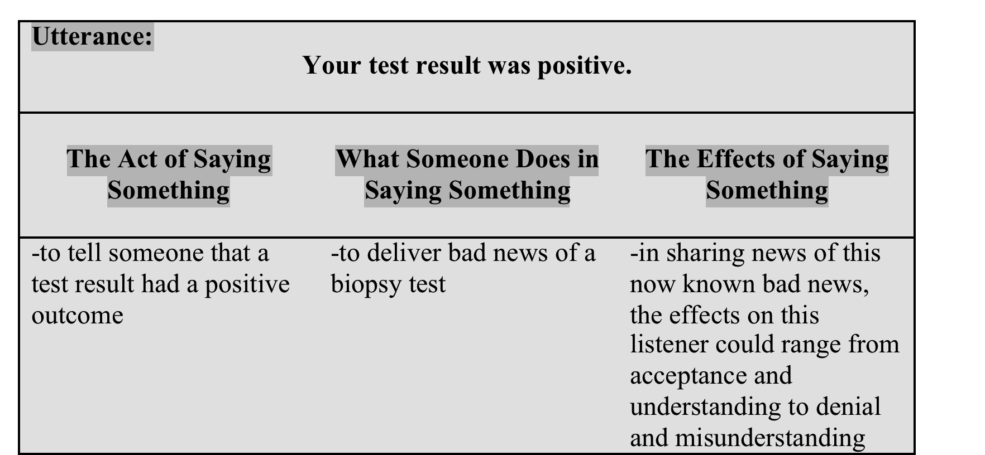
The Effect of Words

Slide 13
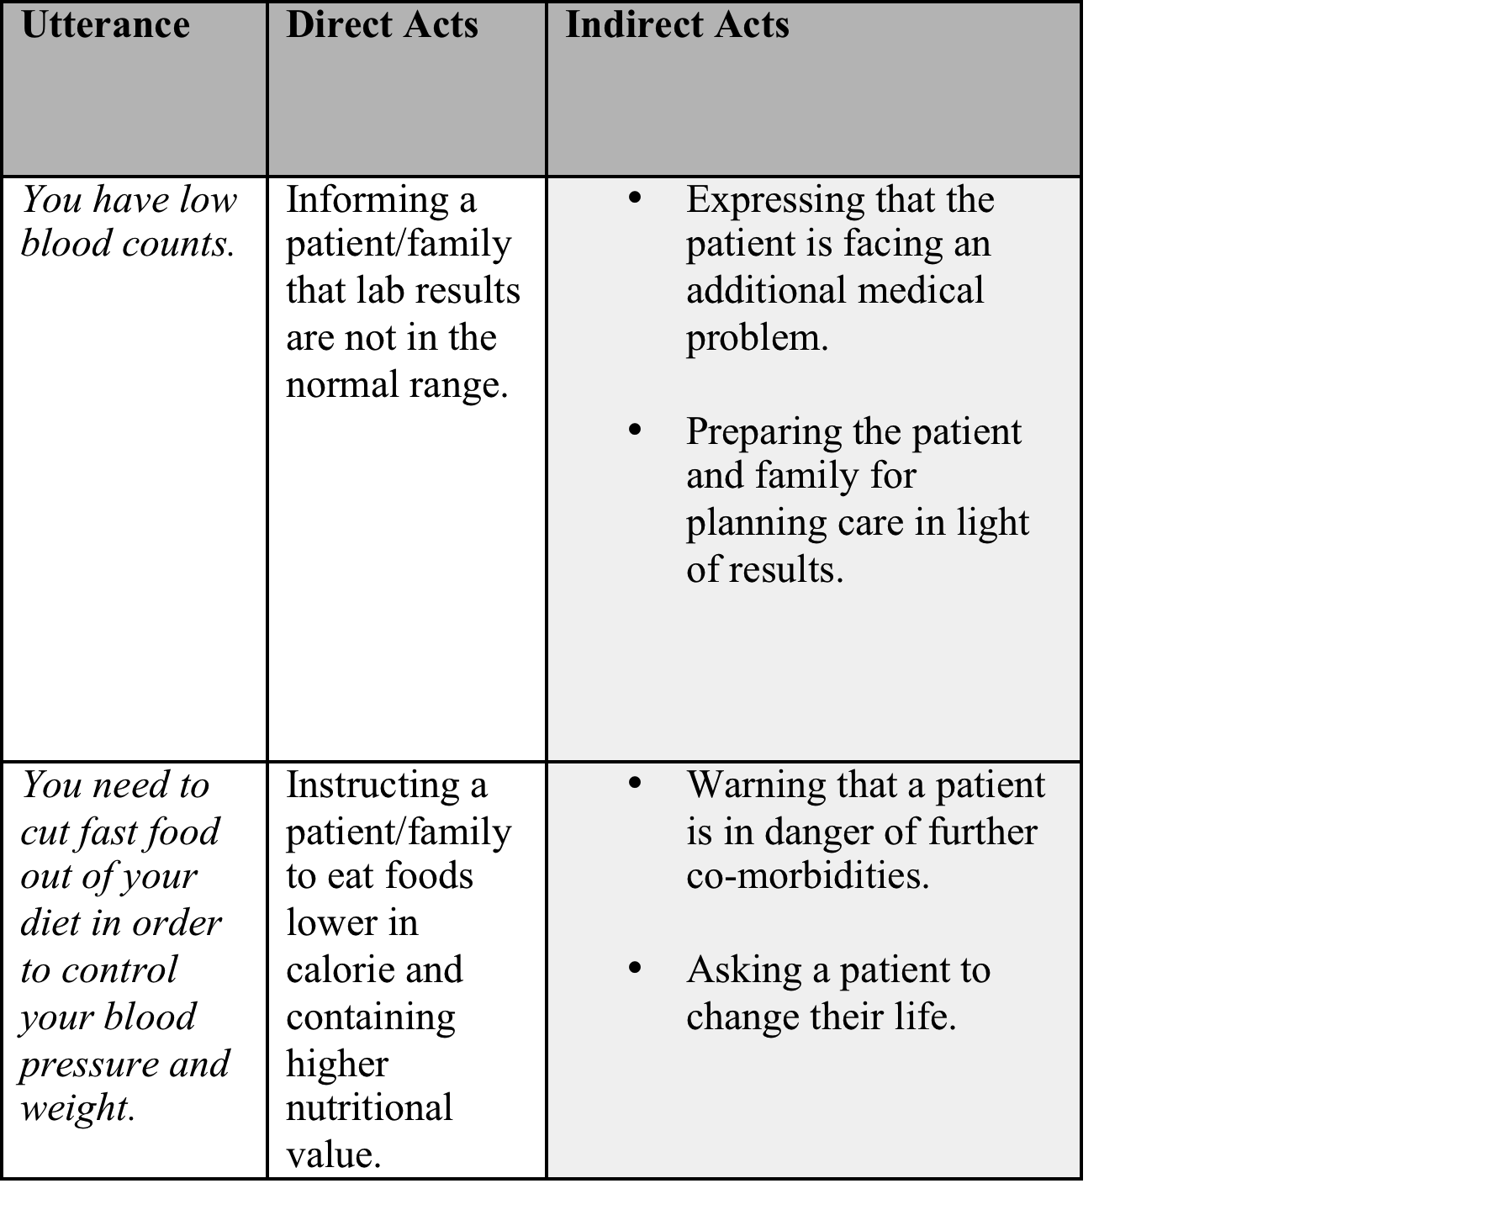
What someone is doing in saying something

Slide 14
Multiple Goals at Play
Task level
Relational Level
Indications in Speech Acts (Direct and Indirect)
Notes:
Complementary behaviors are more important/beneficial to patient-family-nurse intimacy than reciprocal behaviors

Slide 15
In Practice…..
Adaptive Communication:
-give them time and space
-try again with a new tactic
Diffusion of Topics:
-do not force a piece of information
-follow family need
-suspend the need to achieve

Slide 16
Team-Based Relating
Adaptation as opposed to agenda
Multiple Goals need attention
Team-Based and Family Interactions
    -use your team
    -employ the complexity of the family

