Slide 2
COMFORT*
Communication (narrative)
Orientation and opportunity
Mindful presence
Family
Openings
Relating
Team
* Wittenberg-Lyles, E., Goldsmith, J., Ferrell, B., & Ragan, S. (2012). Communication and palliative nursing. New York: Oxford.
Notes:
Red indicates what this session will highlight as they are entry level communication skills for hospice and palliative care

Slide 3
Objectives
Define the practice of accommodation in clinical encounters
Describe the role of health literacy in clinical communication
Understand how cultural theory connects to patient and family health literacy
Identify two communication skills that assess for health literacy and cultural diversity

Slide 4
Framework for understanding
  Orientation (to life-limiting illness):
    Communicating patient’s status & care options
  Opportunity
    Appreciating and articulating opportunities for treatment & care
Notes:
We want to begin by sharing two ideas that are essential to patients and families facing serious, chronic, and terminal illness.
You are in possession of unique information---and communicating a patient’s status and options for care can comfort as well as empower a patient/family. This is called orientation.
Secondly, committing the communication time and effort to share opportunities for treatment and care supports a patient/family in their illness journey. This clinical communication practice will create a trusting connection between the clinician and patient. #

Slide 5
Costs of Limited Health Literacy
Worse health outcomes
Economic financial costs
  Yearly: $106 to $236 billion
  Projected: $1.6 to $3.6 trillion
Indirect costs
  Increased chronic illness
  Disability
  Lost wages
  Poor quality of life
  (Vernon et al., 2007)

Slide 6
Health Literacy
Concerns aspects of health information:
Receiving/acquiring
  Use of Internet a growing practice!
Understanding
Using to make health decisions

Slide 7
Added Aspects of Health Literacy
Health literacy also involves:
  Language
  Context
  Culture
  Communication skills levels
  Technology

Slide 8
Some Things to Say to Open the Health Literacy Doors
“What experiences are most important or meaningful for you?”
“What fears or worries do you have about this illness?”
“Do you have other worries or fears?”
“What do you hope for your family?”
“What kinds of needs does your family have?”

Slide 9
Question
When discussing serious or life-threatening disease, what patient and family demographic is at most danger of low health literacy?
  Adults 65+
  At or below poverty
  Non native/non English speakers
  All of the above

Slide 10
Debrief
Indicators of low health literacy include income, education, & age
  Adults 65+
  Non-whites
  Less than high school degree
  At or below poverty
  Non native/non English speakers
ALL PATIENTS AND FAMILIES FACING SERIOUS ILLNESS HAVE LOW HEALTH LITERACY!

Slide 11
Voice of the Lifeworld (Habermas, 1987)
Voice of the Lifeworld (patient/family)
  Understand health within context of daily life
  Versus voice of medicine
  Feelings vs. empirical data
  Global illness impact vs. segments of poor health impact
Clinicians can bridge this divide

Slide 12
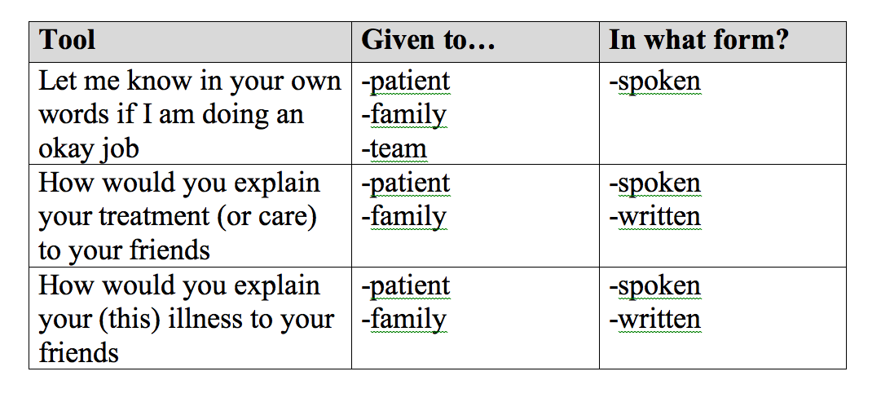
Prompts to illicit feedback

Slide 13
Communication Accommodation (Giles, 2008)
Think of patients and families as:
  Culturally specific
  Facing health literacy challenges
Accommodation assumes that:
  People communicate in similar/dissimilar ways
  Your behavior influences the perceptions of others

Slide 14
Accommodation in Clinical Practice
3 Communication Practices:
Convergence
  adapt/align
Divergence
  increase differences
Overaccommodation
  over-regulating, modifying, responding

Slide 15
Need | Intervention
Message Accommodation | Living Room language Repetition Appropriately gauged examples
Improving Patient/Family Education | Question Co-demonstrations Return demonstrations Patient/family teaches nurse Images Watch video recording together Send video recording home Audio record your meeting
Support needed | Interpreter Chaplain Social worker Psychologist Organ donor coordinator Billing specialist
Message processing | Teach back Printed material clarity

Slide 16
Communication Impairment
Substantial percentage of acutely and terminally ill patients face:
  Motor compromise
  Neurological compromise
  Weakening
  Aphasia
  Delirium
  Confusion
(Lambert, 2012; Salt and Robertson, 1998)

Slide 17
Communication Impairment
Treatments to be addressed : Resuscitation, Ventilation, Non oral feeding, Artificial hydration, Narcotic pain control, Dialysis, Modified diets
Approach:
  Print Material, Video, and Combination
  Speech Language Pathologist and Occupational Therapist consults

Slide 18
Cultural Considerations
Two tenets (culture & power):
Culture pervades/invades human behavior
  Impacts communication, family structure/involvement, health care decision-making
Hierarchical structure
  Social power
  Combined with meaning
  Guides communication and decisions

Slide 19
Cultural Humility
Shift focus from:
Cultural competency
  Identify differences
    Cultural/religious groups
    Death-related beliefs, practices, rituals
Shared understanding
  Value patient/family experience
    Time
    Communication

Slide 20
Cultural Humility
Clean slate for each patient/family member despite cultural orientation
Ongoing active process involving:
  Mindful respect
  Reflection on practice and interactions
  Flexibility

Slide 21
Practicing Cultural Humility
“Where were you born and raised?”
“What language do you prefer to speak?”
“Do you have a preference for a male or female caregiver?”
“Do you have any foods you would especially enjoy, or that you especially like to avoid?”

Slide 22
Team-based health literacy
Clarify that all team members have the same orientation regarding the patient’s plan of care/diagnosis/prognosis
Identify one aspect of health literacy for the patient and incorporate into care plan

Slide 23
Team-based health literacy
Identify 2-3 key medical terms that the patient/family needs to understand and translate
All team members should repeat key medical ideas using lay language during clinical visits.

