Slide 1
Understanding the Problem
Lisa Price, MD

Slide 2
Agenda
Problem statement
SIPOC
Process map
Stakeholder analysis and communication strategy
Identify areas of improvement and review how to make SMART goals
Getting the most out of team meetings

Slide 3
H and P’s and QI projects
H and P | QI project
Chief Complaint and HPI | Problem statement
PMH, PSH, SH, FH, meds and allergies | SIPOC
PE | Stakeholder analysis
Labs, radiology, further testing | Process maps, Pareto diagrams
Assessment and Plan | PDSA
Monitor treatment response | Run charts, quality assurance, dashboards
Notes:
We talk about QI and many people in medicine may have a variety of responses – they recoil, their eyes glaze over when I talk excitedly about fishbones or PDSA’s or run charts, or they say you know – I went into medicine to take care of patients and this is stuff from car manufacturing and the airline industry and not something I feel equiped to do.
But, I really think we are better equipped than a lot of people and here is why….. It is just like working up a patient and the steps are not very different than doing an H and P.
In medicine, we have tools that we use to ensure a more consistent product. The H and P is good example of this- in QI terms we would call it “standardized work” When we look at an H and P, no matter what service – surgery, peds, orthopedics, int med- there are standard components we expect to find. It helps the reader find information, but it also helps the writer not forget important steps in gathering information.

Slide 4
Problem Statement
The chief complaint and HPI of your project
  What is the problem?
  Where is it happening?
  Who is experiencing this? And in what context?
  How frequently?
  I know this because…..
Notes:
When it comes to QI projects, the mistake that I see time and time again – is that we identify a problem and jump immediately to the solution. I know, because I have done it. But if you think about QI as a parallel to an H and P – it would be like jumping to a treatment plan right after you hear the chief complaint of chest pain. That is really just the very very beginning of our work. We then start asking about the HPI – what is this chest pain like, where is it, what brings it on, what makes it go away, etc, etc. This beginning investigation can launch us in the direction of GERD, anxiety, to ischemia and AAA –
A well crafted problem statement is just that important to your QI project. It starts your team charting your course. Answering these questions isn’t exactly hard, but answering them correctly is as important as your HPI sending you from GERD to MI to AAA.
Now, break into your teams and take 5 minutes to craft a problem statement for your project.

Slide 5
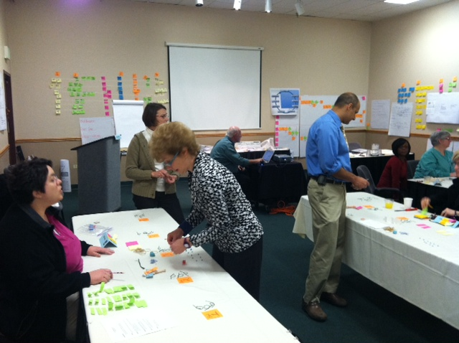
SIPOC
The SIPOC exercise is equivalent to meds, allergies, PMH, PSH, SH, PE
Supplies you will need:
  colorful post it notes
  marker
  camera to take picture
Notes:
Image owned by Lisa Price (author), October 2011. Used with permission.
SIPOC is a tool that comes to us from six sigma. It is a tool to perform what is essentially a high level process map – the start of you understanding the processes involved in your problem.
I thought it would be best if we demonstrated how to do this here – so you can work on this with your team.
You will need post it notes, a marker and a camera to take a picture of your work.

Slide 6
SIPOC
Supplier
Input
Process
Output
Customer
Requirements
Problems
Notes:
So, SIPOC are a pneumonic – it stands for……
So if we try to have a demonstration - I like to start with the process steps I have identified and place them under P
Then I like to identify who the customer is and start thinking about what they need and identify the output. Then work on the supplier and what inputs they need to do their job.
SI and OC are nouns –P is verb.
I have added Requirements and Problems to this – because inevitably you start encountering problems – either know about and need to put it aside, or you may identify things that you don’t know and need to get a better understanding of.
You want to have a chance to review your SIPOC and process maps with your stakeholders to make sure you have it right.
Problem: My friend owns a small restaurant. His problem is he needs to make more money. He does this by maximize throughput through his restaurant by turning over tables but needs to still needs to maximize revenue by encouraging patrons to order high margin items – specials and drinks. He knows his rate of these items drops off 30% at peak hours, and turn overtime increases 25%. This occurs every Friday and Saturday night from 6 – 9 and he knows this because he tracks inventory and orders and can measure turn over time by reservation.
Processes- make reservation, seated by hostess, she notifies waiter that table is ready, he takes drink orders and informs us of specials, takes drink order to bar, make drinks, notify waiter drinks ready, deliver drinks, take order, deliver order to prep cook, meals made and notify waiter meals ready, serve meals, eat, clear plates, serve cake and champagnt, clear plates, deliver,bill pay
Customers: hostess, us, waiter, customer, waiter, bartender, waiter, customer, waiter, prepcook, waiter, customer, waiter, customer, dishwashers, customer, restaurant
Outputs- reservedtable, filled table, notified waiter, order for drinks, notification drinks are ready,

Slide 7
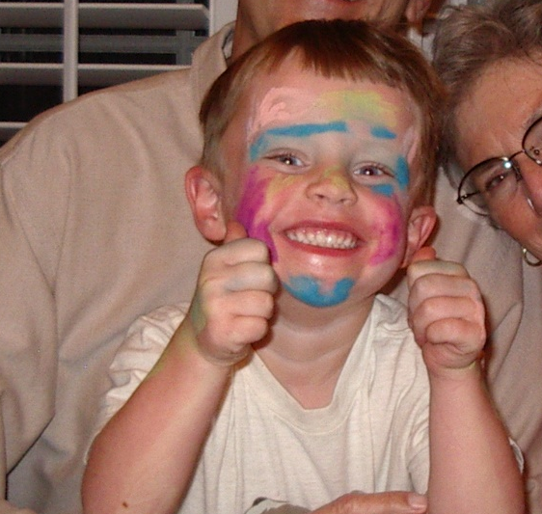
That's not apple juice that's alcohol! Toddler accidentally served margarita mix at Applebee's By DAILY MAIL REPORTER
Notes:
Image by Lisa Price (author), release included.

Slide 8
Who are your stakeholders?
The S and C’s of your SIPOC
Develop a communication strategy
    Understanding of their requirements
    Understanding of their problems
    Sense of urgency
    Communicate the new process
    What will success look like?
    How will we know if we failed?

Slide 9
Process Maps
Your process maps are your labs and radiology tests
You develop a deeper understanding of the current process and begin to see areas of improvement
Supplies you will need: Big sheets of paper, marker, post-it notes
Rectangles are steps in the process
Diamonds are decision points.
Arrows show flow, and circular points show areas of potential waste
Notes:
The process mapping or swim lane diagramming is where you start delving into the deepest points in your process. You have a chance to understand every step, build on to your communication with your stakeholders and identify areas of potential waste or opportunities for change.
In your coaching session, we will spend time working on this – because they will be highly dependent on your project.

Slide 10
Areas of Improvement
Degree of Impact
High
Low
High
Amount
Of
Effort
Low
Notes:
After we understand our process – we will find areas of opportunity to improve and we have a variety of methods to effect change. These are highly specific to

Slide 11
Areas of Improvement
Degree of Impact
High
Low
IT solutions – “hard stops” | Educational sessions Reminders
Order sets and protocols | Posters and signs
High
Amount
Of
Effort
Low
Notes:
After we understand our process – we will find areas of opportunity to improve and we have a variety of methods to effect change. These are highly specific to

Slide 12
Make your goals SMART
Specific
Measurable
Achievable
Relevant
Timely

Slide 13
Managing Your Team
Agenda for your meetings
  Include action items from last meeting
  Problems you want to solve
Action items and assignments
Summary of the meeting
  Post on blackboard to communicate with team

